Slide 1
AI-Enhanced vs Legacy Digital Forensics and Investigation Tools – A Comparative Efficacy Analysis
Team Name: Byte Harbor Butchers
Team Members: Matt Baker, Sam Davies, Olivia Hey, Dave Sushames
Project Client: Geoff Gordon
Advisors: Dr Bryce Antony, Clement Swarnappa
IT7510 Capstone: Final Panel Presentation

Slide 2
Presentation Content
Background and Problem
Key Milestones
Changes and How They Were Managed
Methodology
Development, Research, Tools, and Technologies
Tools(Investigative)
Tools(Development)
Tools(LLMs)
Tools (LLM – Augmentation Scripts)
Primary Artifact (1/2)
Primary Artifact (2/2)
User Documentation
Demonstration
Testing
Key Findings and Analysis
Stats
Conclusion and Recommendations
Client Review and Satisfaction
Future Work and Remaining tasks
Questions?

Slide 3
Background and Problem
DFIR analysis is slow, manual, and requires high levels of expertise.
LLMs promise faster reporting, but cloud-based AI are not secure.
Any LLMs used have to be locally hosted.
What are the limitations and use cases of this?
Do LLMs belong in DFIR, and if so, how?

Slide 4
Key Milestones
01/09/2026
02/10/2026
28/10/2026
05/11/2026
Final version of proposal
All LLM-augmentation scripts complete
Closeout reports, poster, one-pager
Final panel presentation
16/09/2026
07/10/2026
29/10/2026
09-26/11/2026
Mid Progress presentation
Self management review
Research report delivered to client
Post submission work with Geoff

Slide 5
Changes and How They Were Managed
Change from AI tools to AI reporting. Gantt chart versions. How changes were documented (proposal revisions, meeting minutes with Bryce)
Change | How it was managed
Focus shifted from testing AI tools to comparing LLM reports. | Proposal revised and a new Gantt version issued. Documented through proposal revisions and meeting minutes with Dr Antony
Scripts were initially out of scope, but became necessary | Told the client at the mid-project presentation, Gantt chart updated to include script development
Dropped Kanban/Trello | Advised by Dr Bryce Antony. Using DSR cycle + a shared file-tracking doc
Extra post-panel work agreed on | Frontier-model testing with added to Gantt for after exams

Slide 6
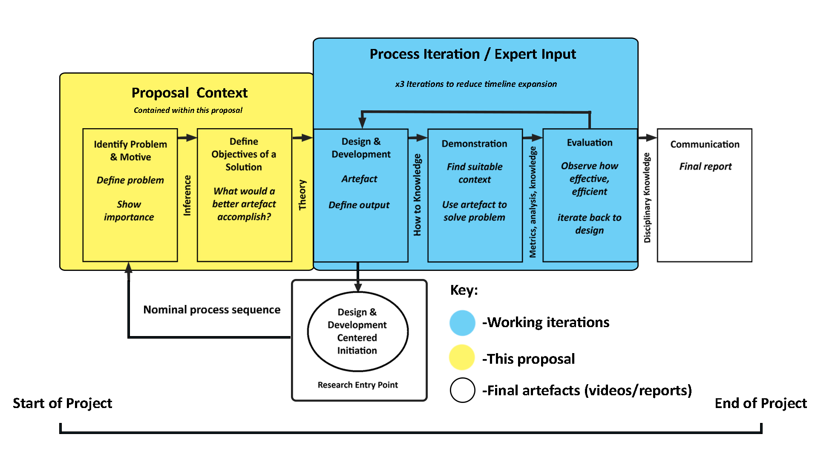
Methodology
Design Science Research: Problem -> Objectives -> Design -> Demonstration -> Evaluation -> Communication
NIST CFTT: Structure for comparing tool output.
DSR was adapted, taking advantage of expert-informed iterations of key artefacts.
Kanban + Trello was tried, but had limited utility so wasn’t used.

Slide 7
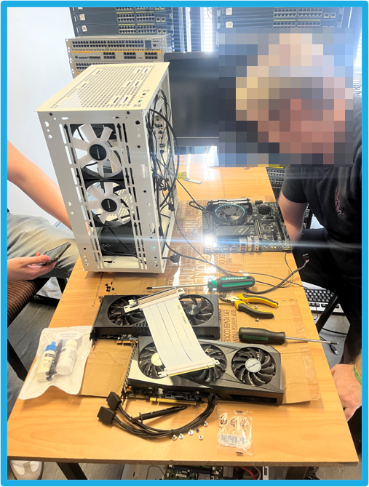
Development, Research, Tools, and Technologies
Testing Environment:
Kali Linux 2026.3, i5-13500, RTX 3060 + RTX 3070, 2x8 GB DDR5 Memory. Installed on campus. Connected to via RDC and PuTTY through OpenVPN tunnel.
LLM hosting: Ollama, Gemma4:26b custom build (32k context, temperature 0, fixed seed).
Traditional tools: Foremost (file carving), Nmap (network scan), Wireshark (packet analysis).
Scripts: Python/Bash scripting.
Other models tested: Qwen, Mistral, Nemotron. Gemma4 was fastest, clearest, and had the fewest errors.
DSR, Kali Linux, Ollama, Gemma4-df at specific parameters. Foremost, Nmap, Wireshark, Tshark.

Slide 8



Tools (Investigative)
Foremost
Nmap
Wireshark
A digital forensics tool used to carve files from a forensic disk image. Used to recover data from hard disk storage for investigative purposes.
A network reconnaissance tool that can be used to discover hosts, open ports, services, vulnerabilities, and other technically specific diagnostic information. Used for network triage.
A packet capturing and packet inspection tool. Used for network analysis. Tshark.

Slide 9


Tools (Development)
Python
Pandoc
Toon-parse
Coding language for LLM-augmented tools, preferred for local deployments, supports many APIs and modules facilitating LLM and LFS comms.
Facilitates markdown to pdf conversion
Facilitates conversion of XML to novel token optimized language

Slide 10
Tools (LLMs)
Gemma4:26b
Gemma4-df
Qwen3.8-Flash-Next
26 billion parameter MoE model
Of all models tested, the most efficient, least erroneous
Custom improved model
Set seed
Temperature 0
32k context
Repeat penalty set to 1.0
“Frontier model”
Provisioned through “Strata”
125 billion parameter MoE model
.262,144 - 1,000,000 context

Slide 11
Tools (LLM-Augmentation Scripts)
NinemostV1
SilentCartographerV1
HammerheadV1
Longest development time, proof of concept
Originally designed to inspect every file of foremost output
Least sophisticated and useful
Token counting added
Where chunking/input conversion was added.
Employs novel formats (TOON)
Most realistic and deployable script
PDF output conversion was added
Largest challenge to context problem
Uses tshark to selectively pick packet columns > csv
Further experimental evolutions, V2, V3
Could make a great future project (deep packet inspection)

Slide 12
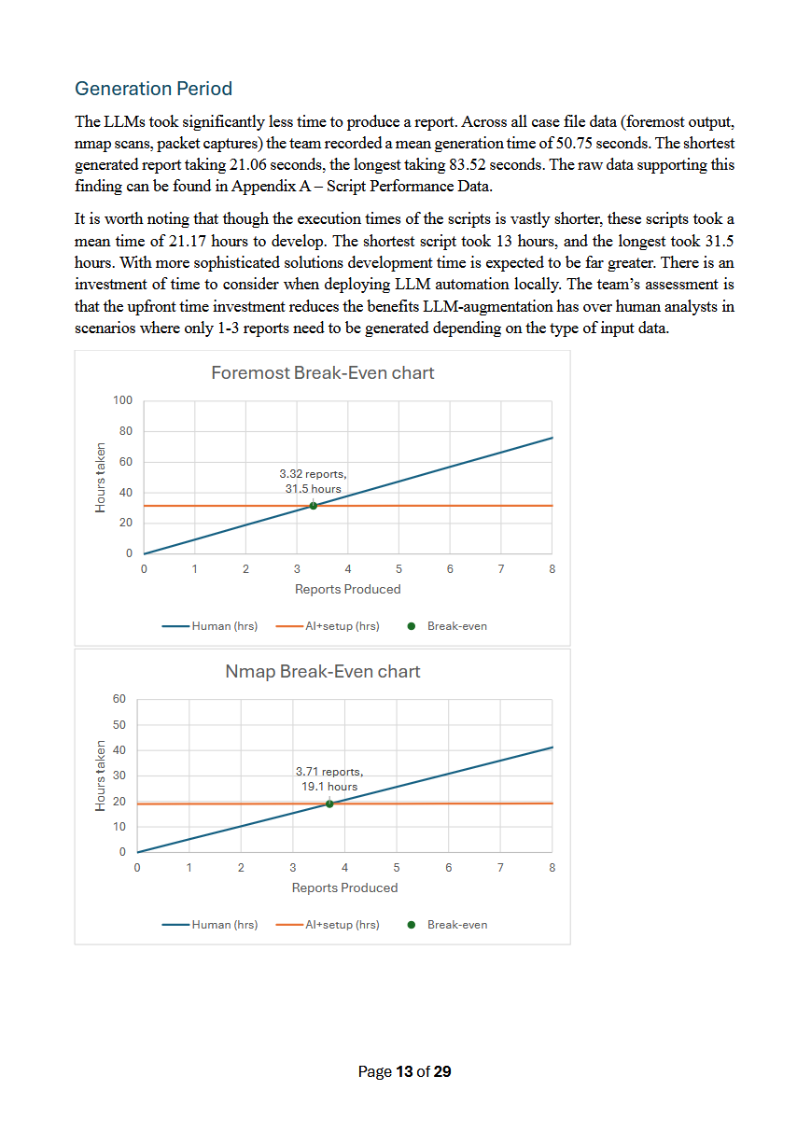
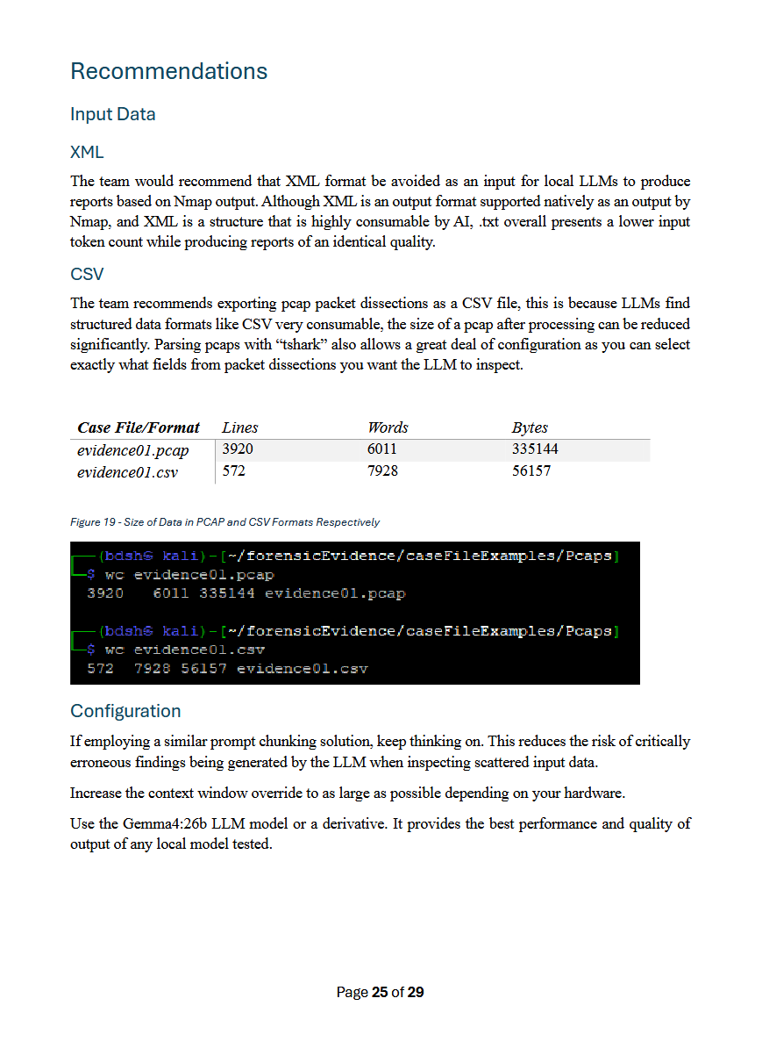
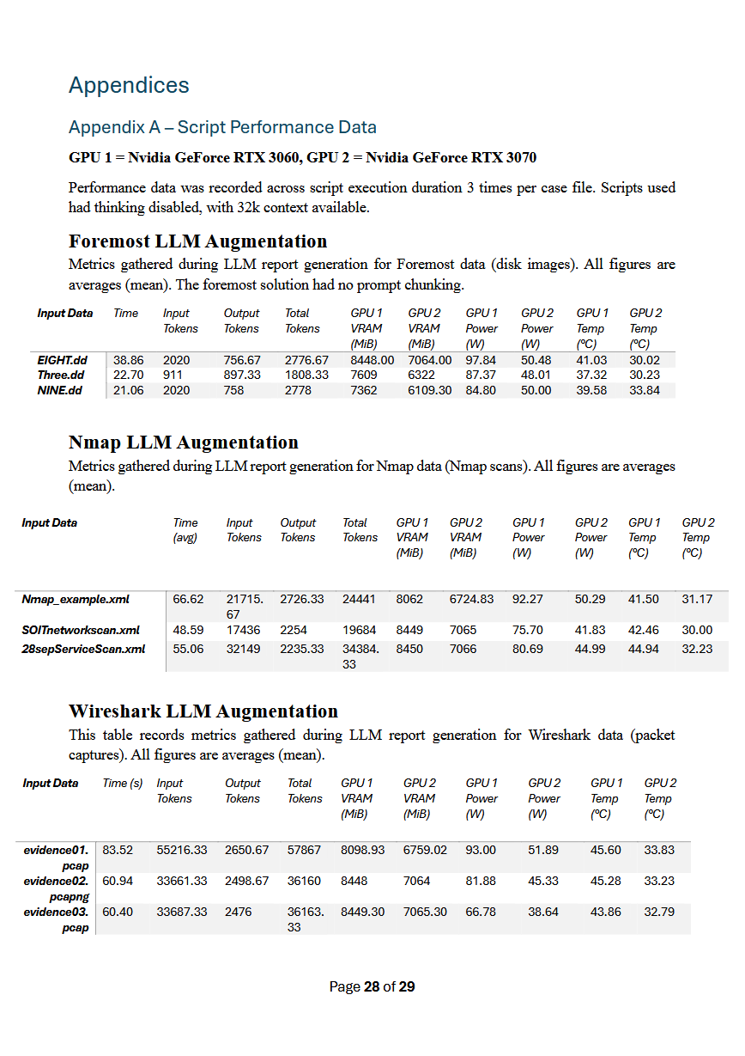
Primary Artefact (1/2)
Research report for Geoff presenting research background, methodology, findings, statistics, conclusions, recommendations, and support for future research.
We successfully answered Geoff’s concerns and interests about AI in DFIR.

Slide 13
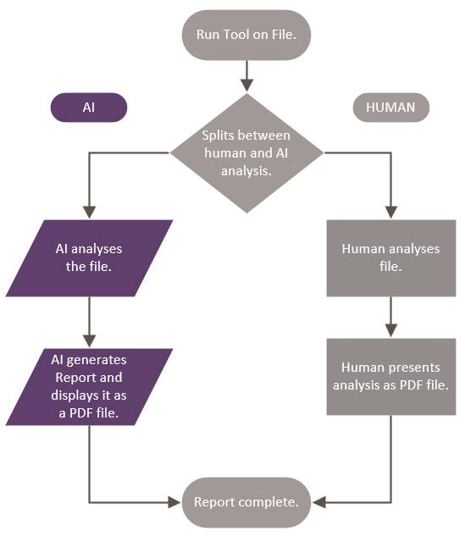
Primary Artefact (2/2)
Qualitative + Quantitative testing scheme
Scripts convert input data, chunk, generate LLM report, convert to pdf, and save temporal and token metrics.
Performance data recorded in tandem
3 testers with 1 case file per tool each for averages.
Quantitative stats consolidated and formatted into graphs.
Qualitative assessments made by evaluating both reports on the same case file.

Slide 14
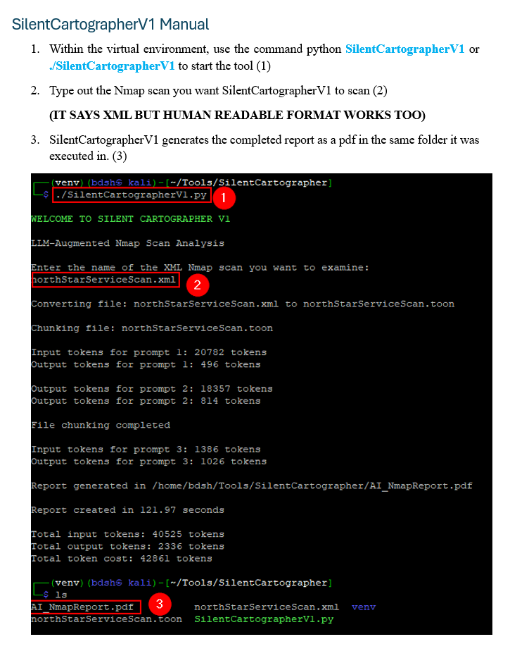
User Documentation
The client closeout report contains manuals for every LLM-augmentation script.
This includes how to deploy a virtual environment, install the required prerequisites, and run the tools correctly.
Anyone can follow these instructions to employ the tools.

Slide 15
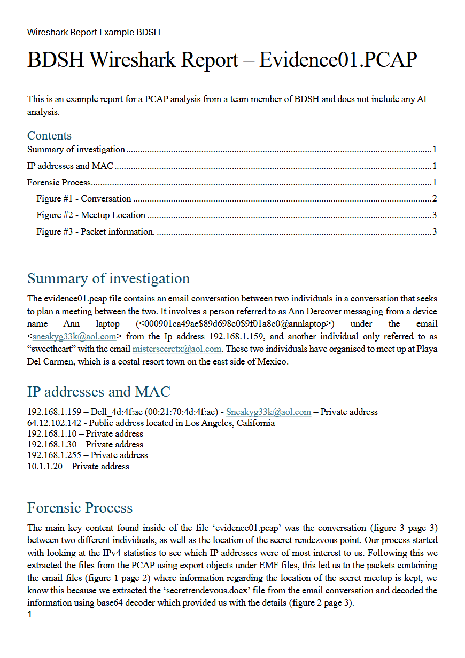
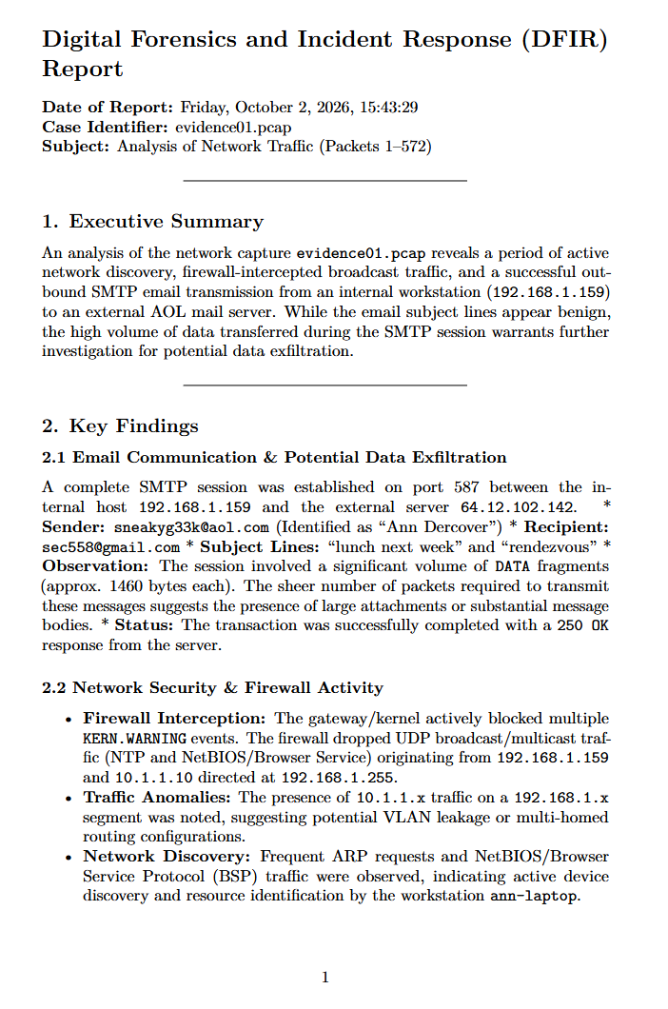
Demonstration
Demonstrate scripts, troubleshooting methods, report comparison.

Slide 16
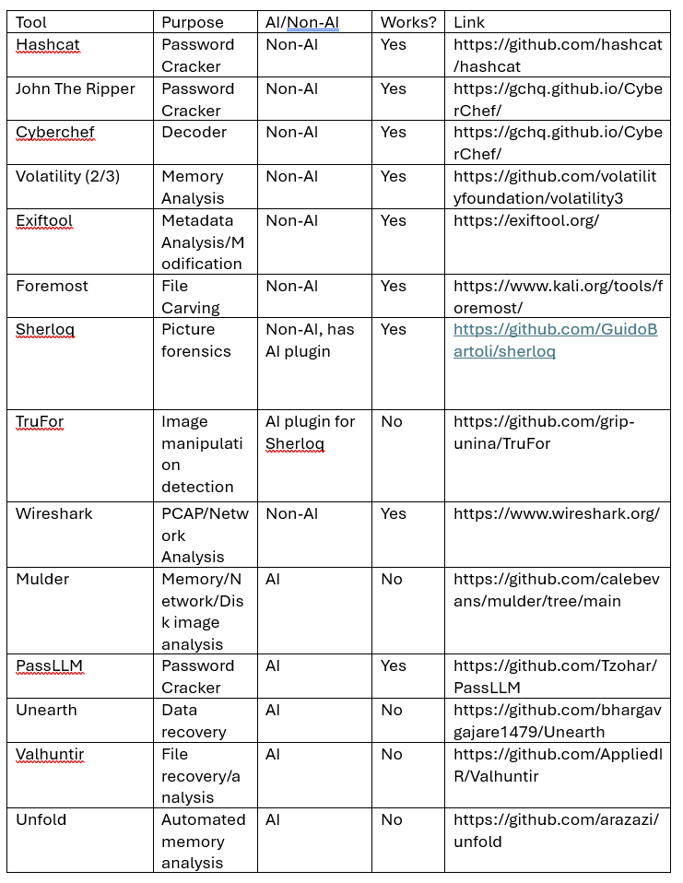
Testing
Tested AI and conventional DFIR tools for viability
Tested potential locally hosted LLMs, identifying emerging limitations
(Qwen, Mistral, Nemotron)
Prompted solution to find context window
Testing context of modified models through token counter, Ollama ps
Model parameters override global parameters
File cleanup line for identifying problems with conversion, context issues
Leaving Ollama verbose output on, problem with regular expression
Qualitative testing on report quality
Active hardware performance testing with nvtop, htop
Hardware performance stats collected with nvidia-smi

Slide 17
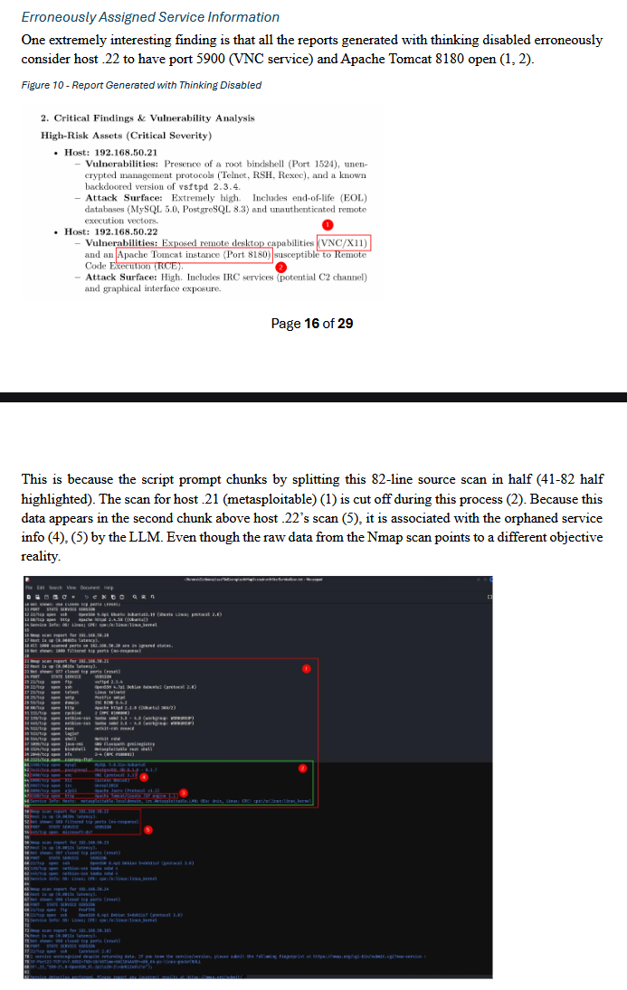
Key Findings and Analysis
LLM Successes | LLM Omissions | LLM Failings
Tool and evidence details | Per-file descriptions | Misattributed ports
Summaries, host identification | Limitations | Hallucinated packet range
Speed | Rejects corrupted images | Missed “iknowyourewatchingme”
Reasons include limited context, prompt chunking splitting data mid-record, one image per prompt, and reports limited to a fixed length.

Slide 18
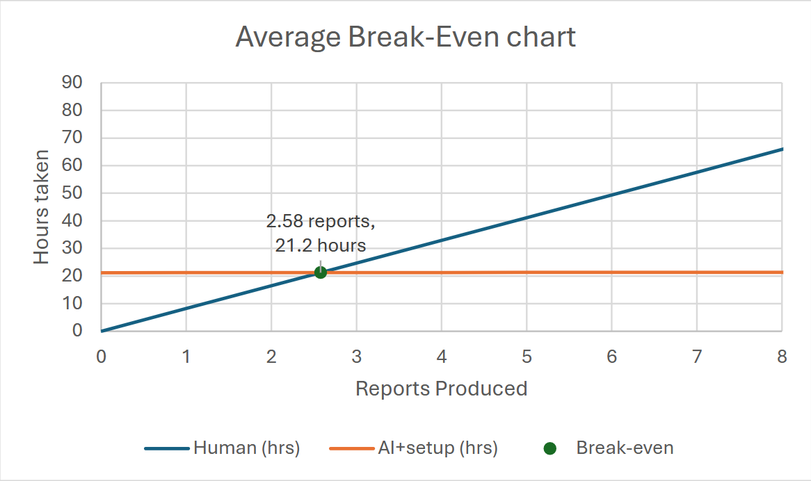
Stats
Human report time
Average (mean) time for a human analyst to create a report
8.23 hrs
(2-21.5 hrs)
LLM Report time
Average (mean) time for the LLM to create a report
50.75s
(21.06-83.52s)
Script development time
Average (mean) time to write the Python script for the LLM
21.17 hrs
(13-31.5 hrs)
Break-even
Number of reports and time it takes for
2.58 reports, 21.2 hours
Notes:
D/S

Slide 19
Conclusion and Recommendations
Conclusions
LLM reporting is best used as IR triage, and quick first-pass summaries. Good for “finding a thread to pull” .
Less useful where integrity, traceability, and completeness matter. Output needs expert validation (DF).
Provisioning, deploying local LLM-enhanced DFIR solution in small business-enterprise environments is realistic.
Initial time investment to produce LLM-augmentation scripts an inconsequential consideration.
Recommendations
Avoid XML for Nmap
Use CSV for Pcaps
Keep thinking on if prompt chunking
Use Gemma4:26b

Slide 20
Client Review and Satisfaction
When our client was asked if they were happy with the project they replied, "Yes very much so, I am very pleased with the work you guys have done."
Other indicative quotes during our client presentation:
  "You’ve done a fantastic job on this project."
  "The thing I'm doing with that Neuromancer game has come from your project"

Slide 21
Future Work and Remaining tasks
Additional testing with Geoff
Post panel work with Geoff using frontier models.
Hardware installation/configuration week 17
Development/testing week 17/18
For future research
Larger number of prompt chunks on larger datasets.
LLM Augmenting and research focused on a single tool, improving focus and quality of research. (Wireshark deep packet inspection)
Expanding the Foremost script to inspect and describe each file, rather than just working off the output.txt.
Dynamic chunking, automatically setting the amount of chunks based on filesize and context limit.
Hybridized testing scheme
Further investigation into corrupted content/specific limitations of vision models.

Slide 22
Questions?
That’s all folks!

